Slide 1
Contest Problem Review

Slide 2
Some Comments
Thanks for attending our contest!
We hope you come back next year as it will be bigger and have real food (sorry about the food thing, we had some poor communication)
The goal of this review is to let you see how to analyse and solve the problems. A lot of you are competition newbies.
The only way to get better at competitive coding is to solve problems
Most Saturday afternoons at 2PM I have a competitive coding class that covers various topics and allows teams to practice coding a problem and be able to ask questions. If you want to be put on the mailing list let me know. I will likely continue to do these classes over the summer whenever I can.

Slide 3
Learning Tools
I recommend Competitive Coding 4 by the Halim Brothers. It is a two book set that really is a great reference.
Also, Competitive Programmer’s Handbook by Antti Laaksonen. I have this on my github.
There are contests going on all the time online and there is no reason why you can’t enter them. Google competitive coding contests.
I use the UVA and the Kattis judging sites. They have thousands of practice problems. Google ”virtual judge”. This is a portal site to several judging sites.
I will be looking for some additional contests that might be fun to try and I will let you all know. There is no reason why you can’t find teammates out of this group!

Slide 4
github
I have started a github for the Saturday coding seminars under ProfGregL.
You are welcome to look at anything there but please do not modify anything without asking. You can download at will.
I will continue to add things to the repo such as this slide deck
My material is not for general distribution!!! Please to not start posting things.

Slide 5
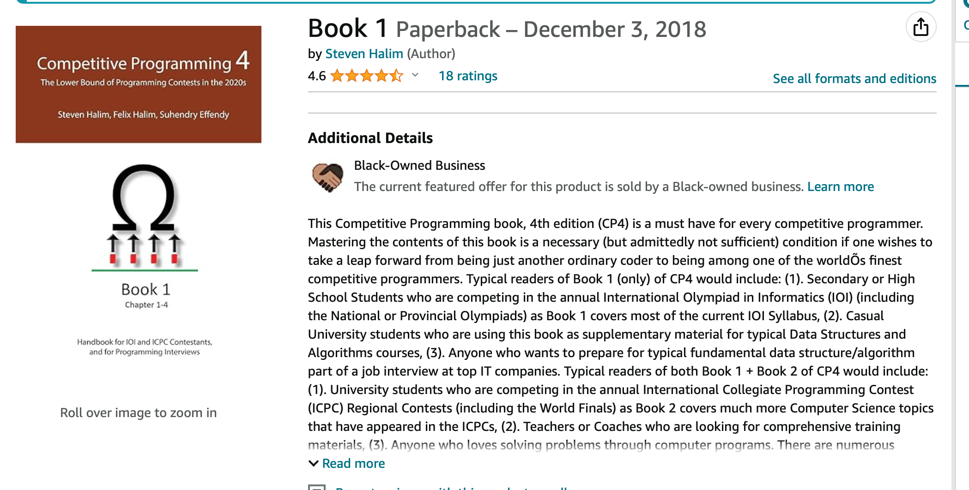

Slide 6
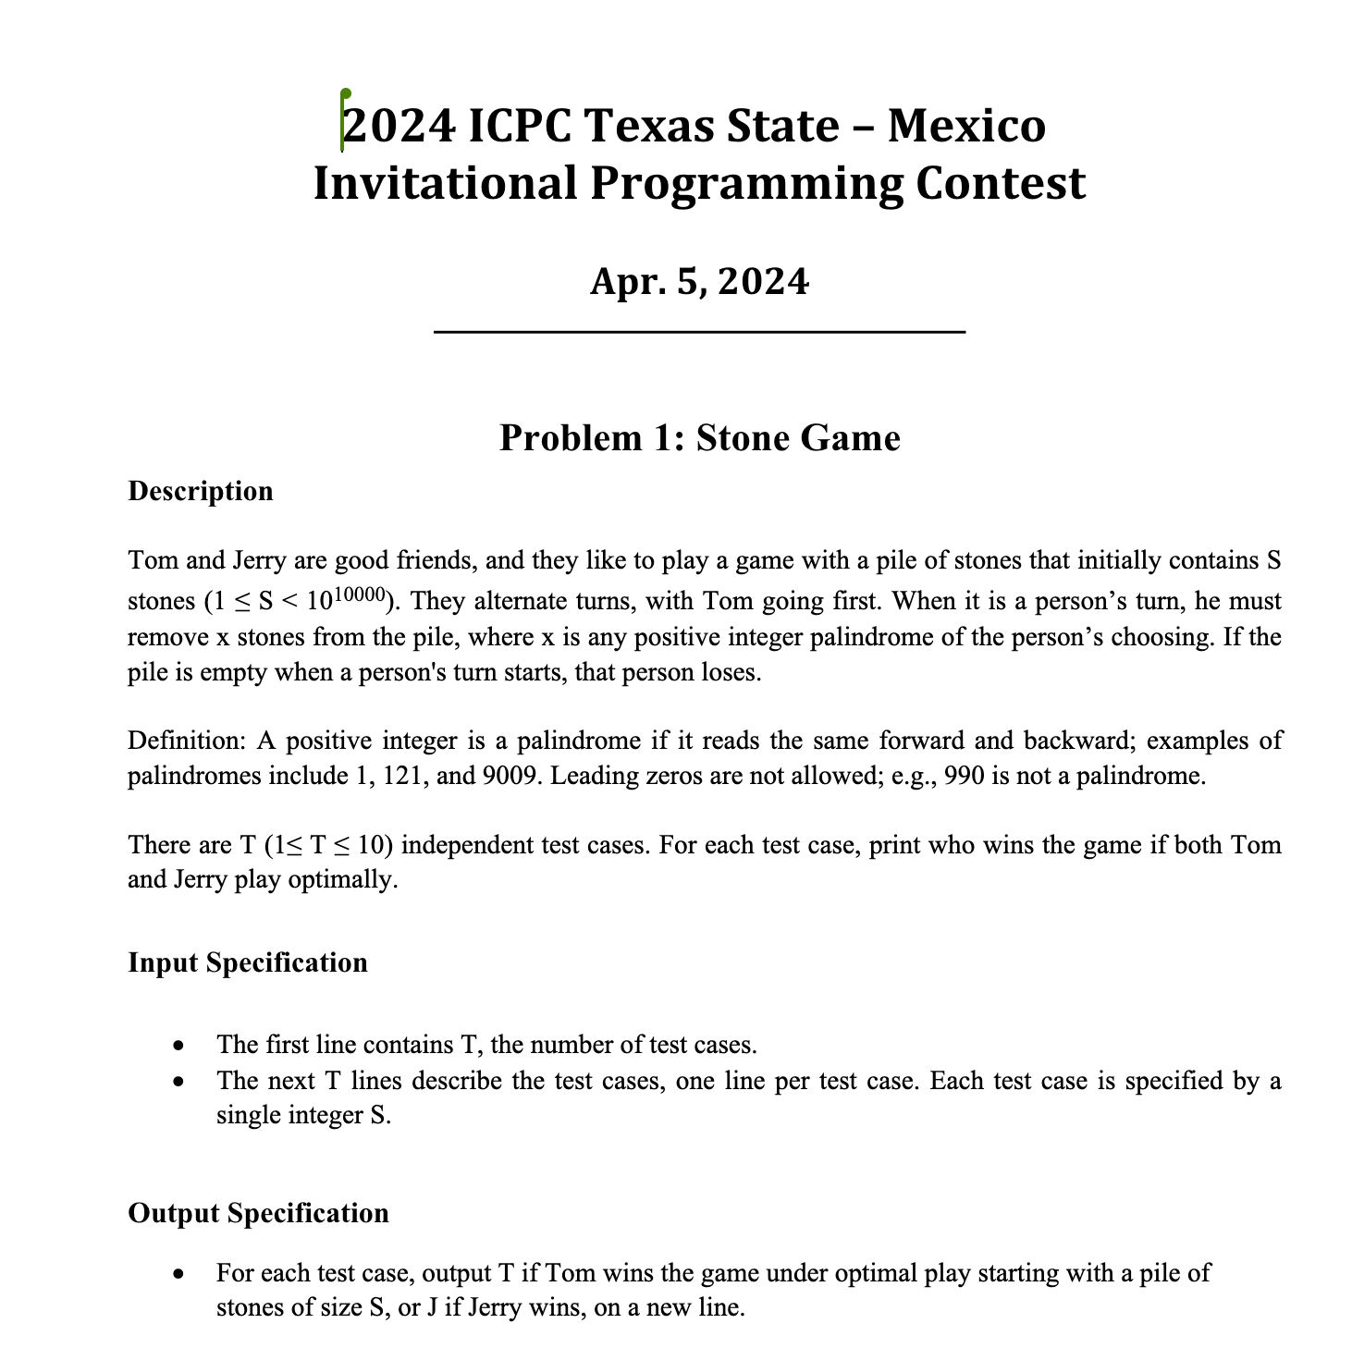
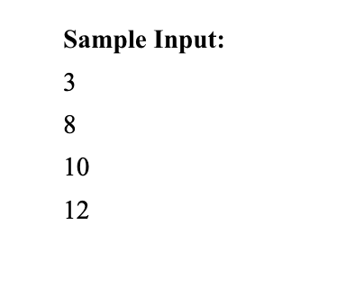
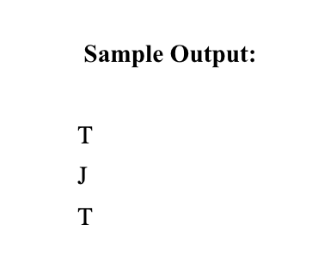

Slide 7
Problem Analysis
This problem is not hard at all but most inexperienced contestants see palindrome and get sucked in to the wrong thinking process
Stone problems(picking problems in general) tend to be Dynamic Programming problems and use memoization to speed up execution
Memoization is writing down the results of subproblems so you don’t have to keep recalculating them.
For this problem I created a table that I think will shed light on the solution

Slide 8
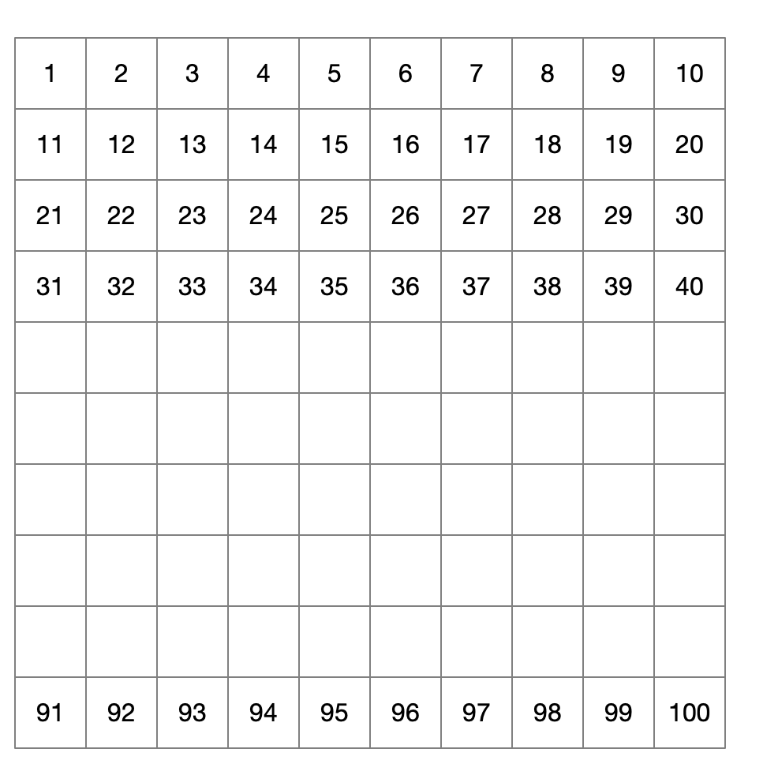
Possible number of starting
stones in pile 1 - 100
. . .

Slide 9
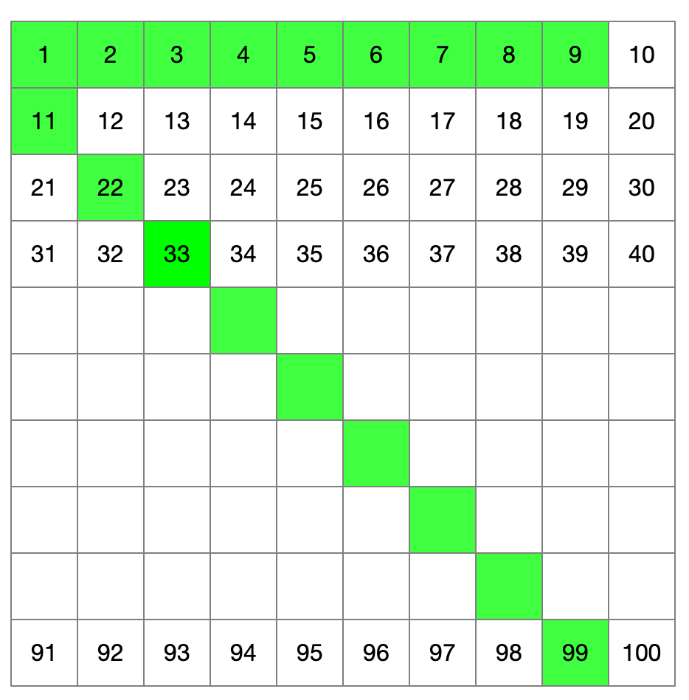
Palindrome numbers

Slide 10
Palindrome numbers

Slide 11
Lets see for each starting number if we can figure out who wins
Say it this way:
If a player is given a pile with n stones will they win or lose
Start with the first row
Since all the single digit numbers are palindrome numbers, if the starting player gets a single digit number of stones, they just pick that many stones and they win - EASY

Slide 12
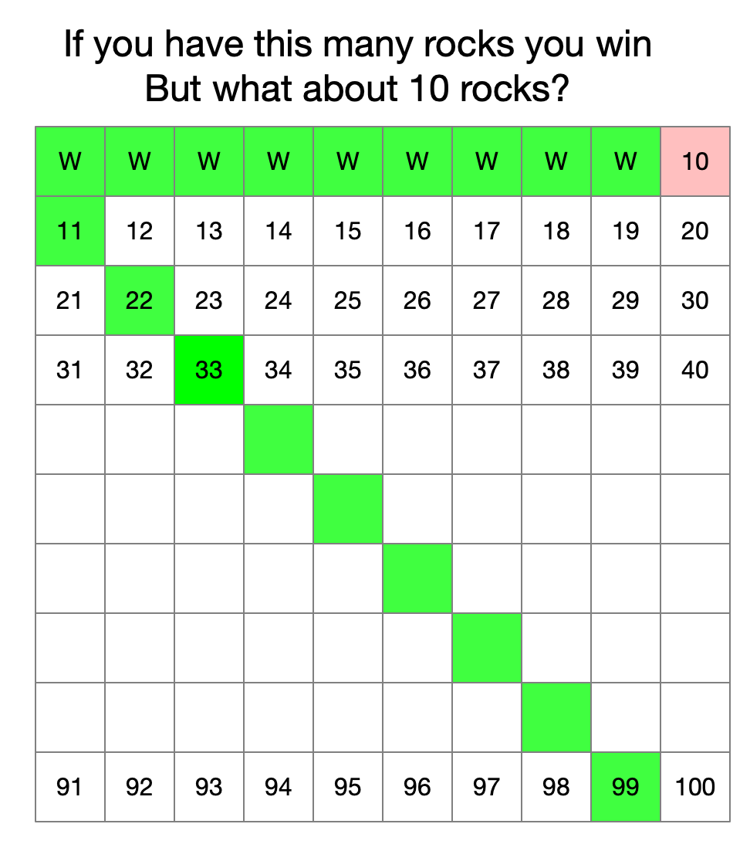

Slide 13
10 stones
If a player gets a pile with 10 stones, they always LOSE since subtracting a single digit number always leaves a single digit remainder for the next player!

Slide 14
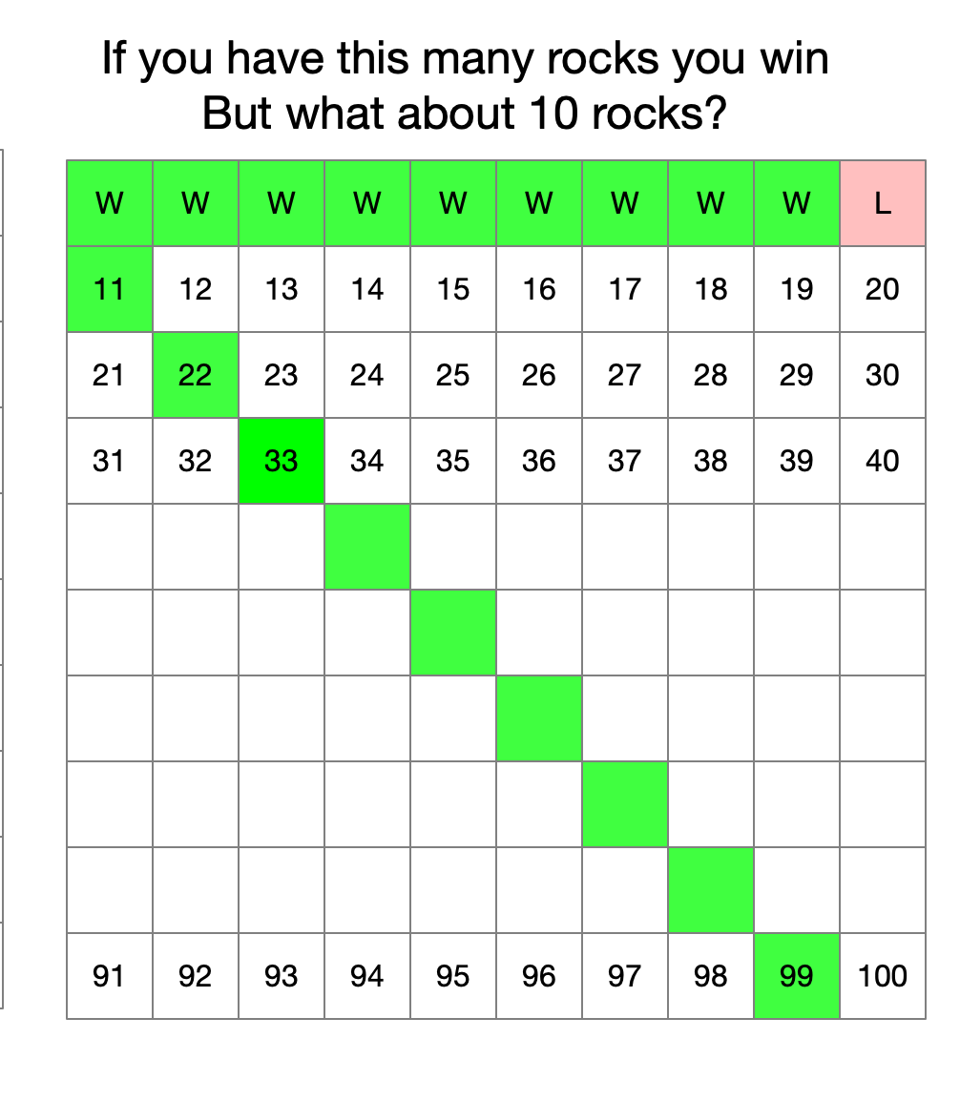

Slide 15
So what about 11 - 20
If a player gets 11 they win since 11 is a palindrome number
What about 12?
A player getting 12 WINS since they can pick 2 stones and give their opponent 10 stones which we know is a losing number
Same for 13 – 19
But what about 20??
It’s the same as 10. If you get 20 then you will give your opponent an 11 though 19 which are winning positions

Slide 16
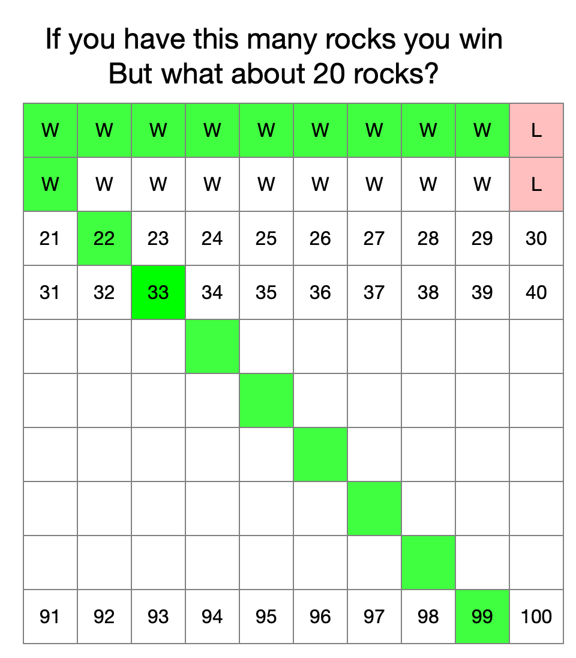
Do you see the pattern yet?

Slide 17
The recurrence relation
Lets say we get the number expressed as a string since we cannot do 10¹⁰⁰⁰⁰ as an int (at least in C++)
If the last character is a “0” then the second player will always win, otherwise the first player will always win (assuming they play and don’t make mistakes

Slide 18
#include <iostream>
#include <string>
using namespace std;
int main() {
int T;
cin >> T;
while (T--) {
string stone;
cin >> stone;
cout << (stone.back() == '0' ? 'J' : 'T') << endl;
}
return 0;
}
.back returns the last character

Slide 19
Python
T = int(input())
for _ in range(T):
start = input()
print(‘J' if start[-1] == '0' else ‘T')

Slide 20
Picking problems, optimization problems
All of these are candidates for dynamic programming
Work it by hand, look for the pattern and the recurrence relation

Slide 21
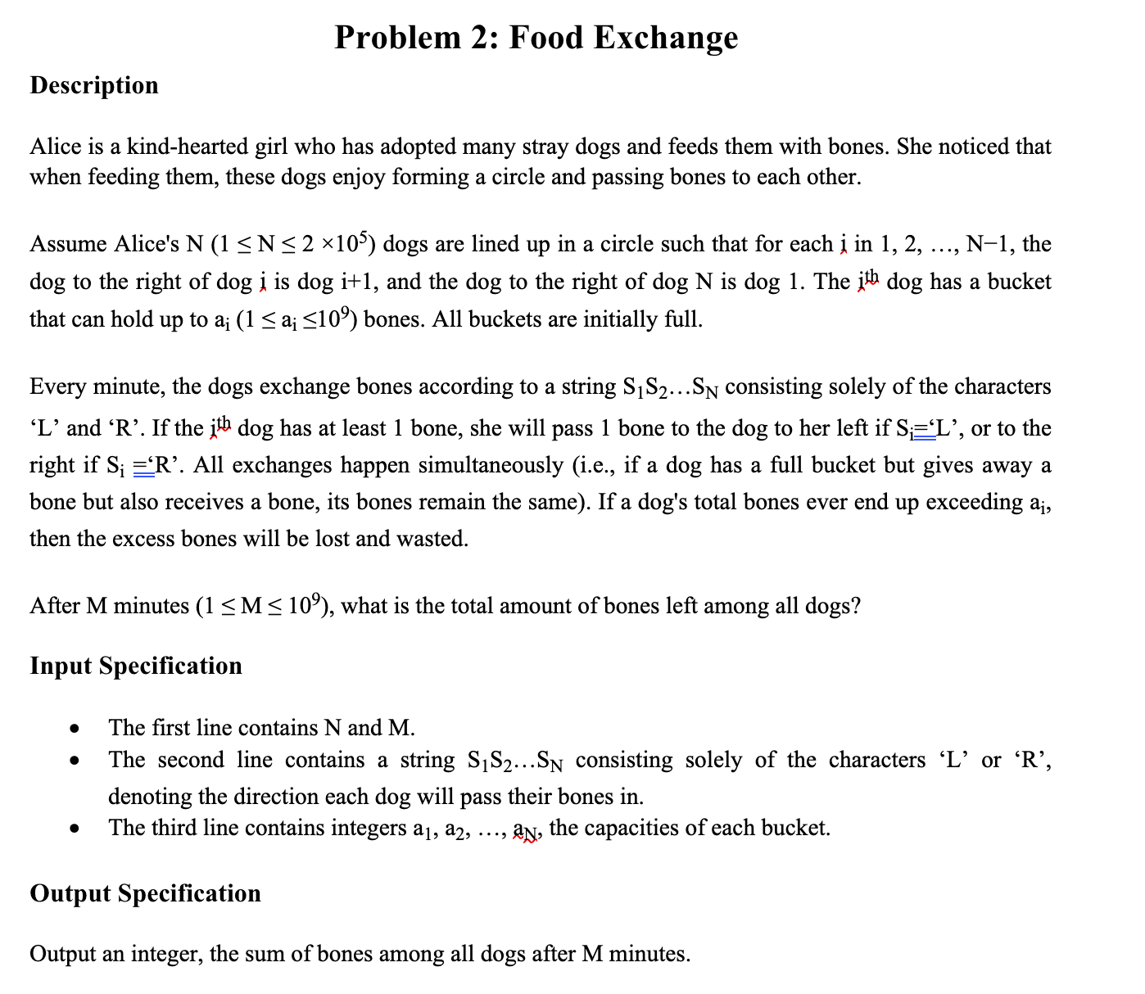
Sample Input:
9 5 RRRLRRLLR 5 8 4 9 3 4 9 5 4
Sample Output:
38

Slide 22
Problem Analysis
This is the most difficult problem to get right because of the interlocking conditions
You can do it brute force and simulate or you can try to figure out something else
At any minute we have to add up the bones on all bowls
The key to this problem is finding the R->L pairs.
The pairs become stable
It is not hard at any minute in to figure out how many bones are in bowls.
Solution finds the R-> L pairs and work around them
Figure out what bowls are not in the stable R->L pairs and recognize they will all eventually become empty
So the trick is minute by minute to figure out how many drop out
If you spend a little time doing things by hand you will see the patterns
The most important thing is to take the instructions literally. For a R->L pair of bowls, they don’t change

Slide 23
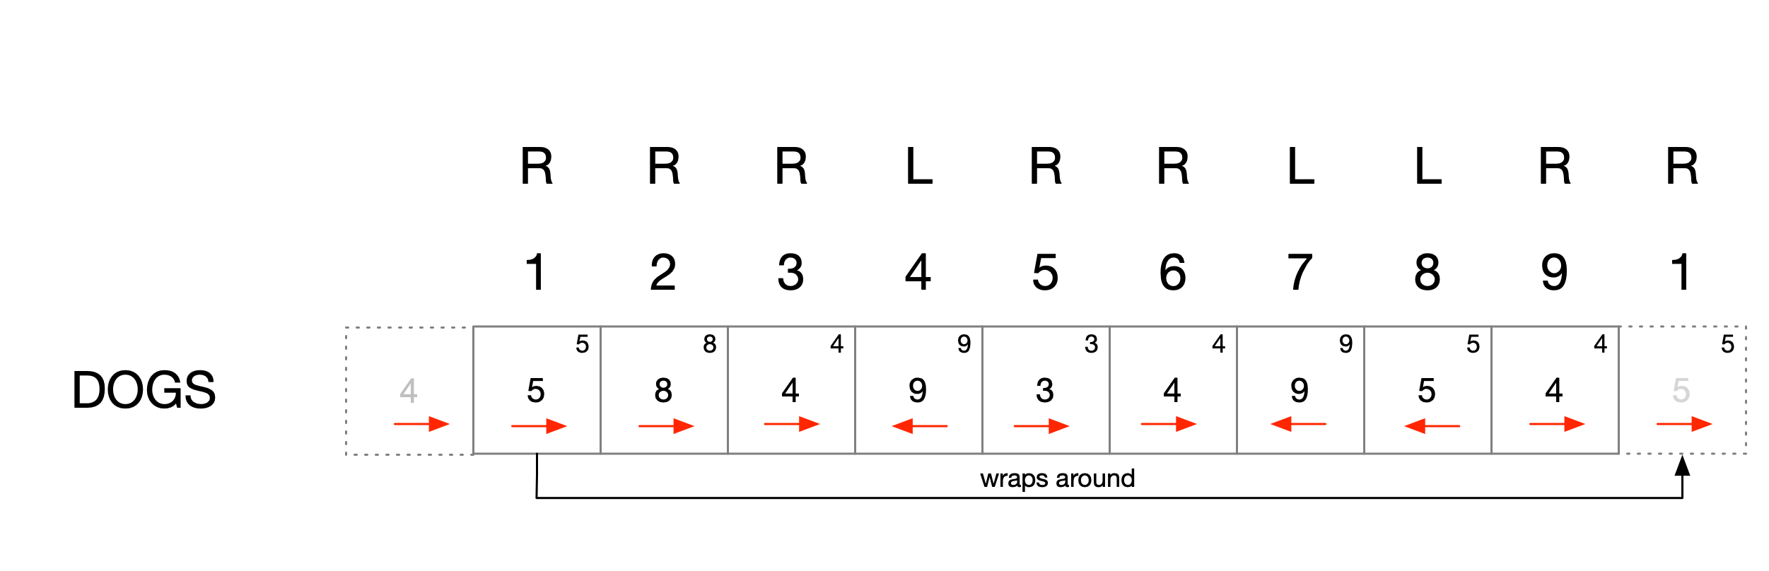
An example:

Slide 24
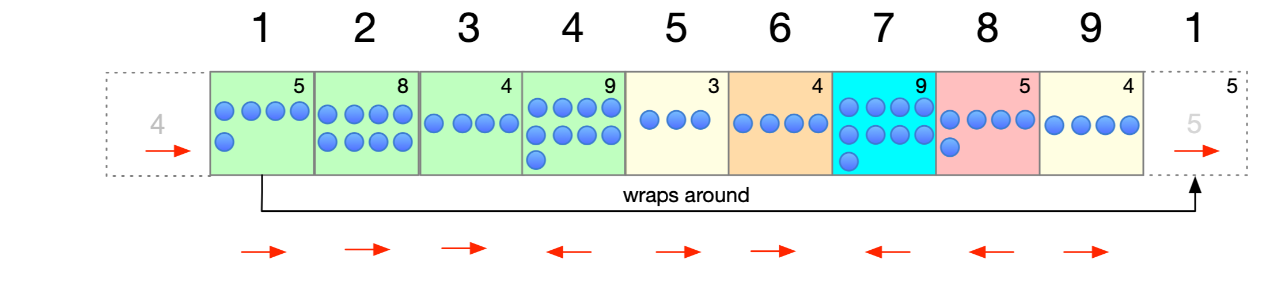
start
Blue dots are bones

Slide 25
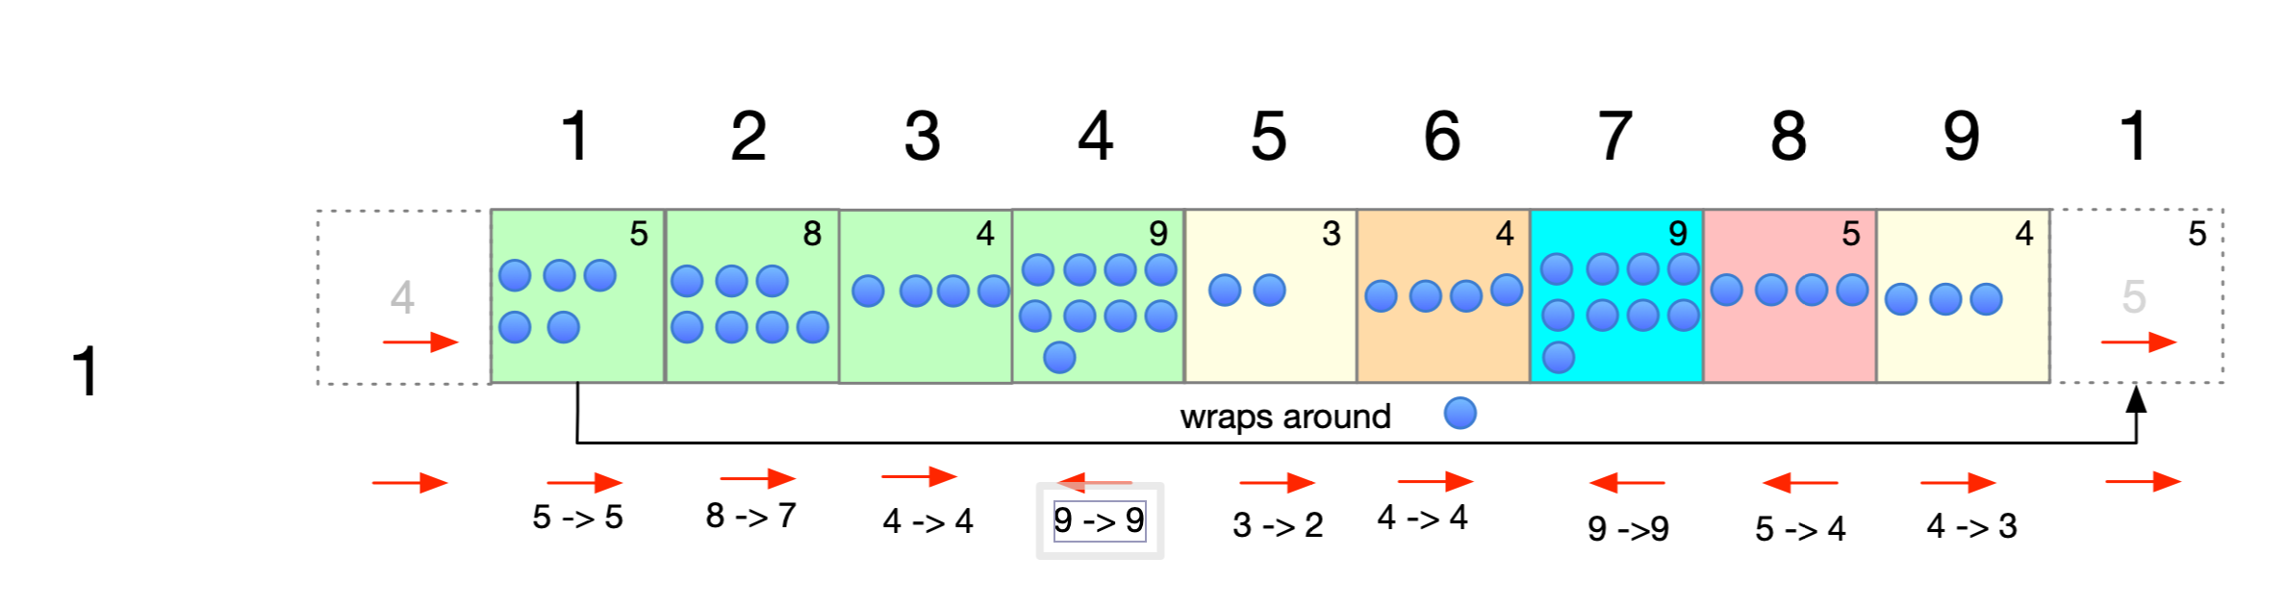
Start
Minute by minute this is after minute 1

Slide 26
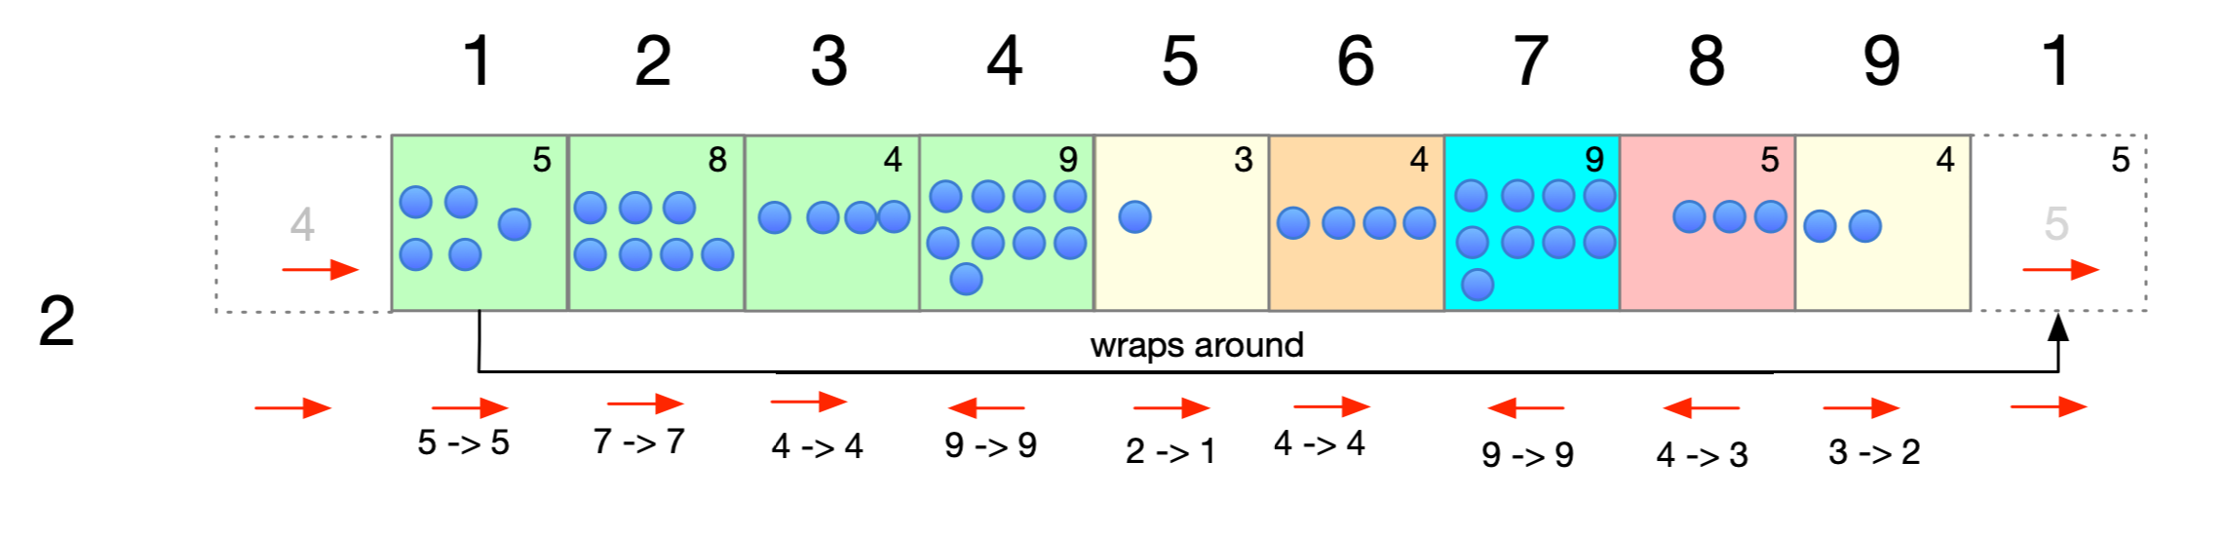

Slide 27
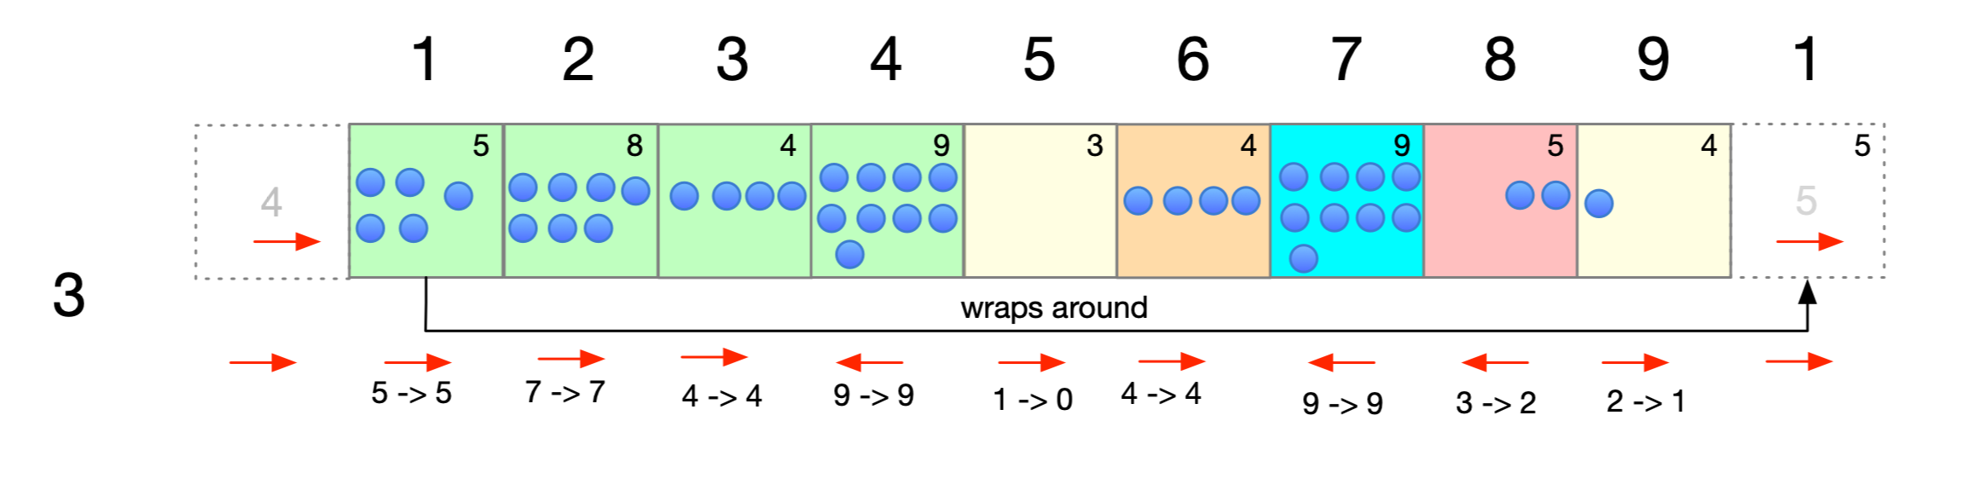

Slide 28
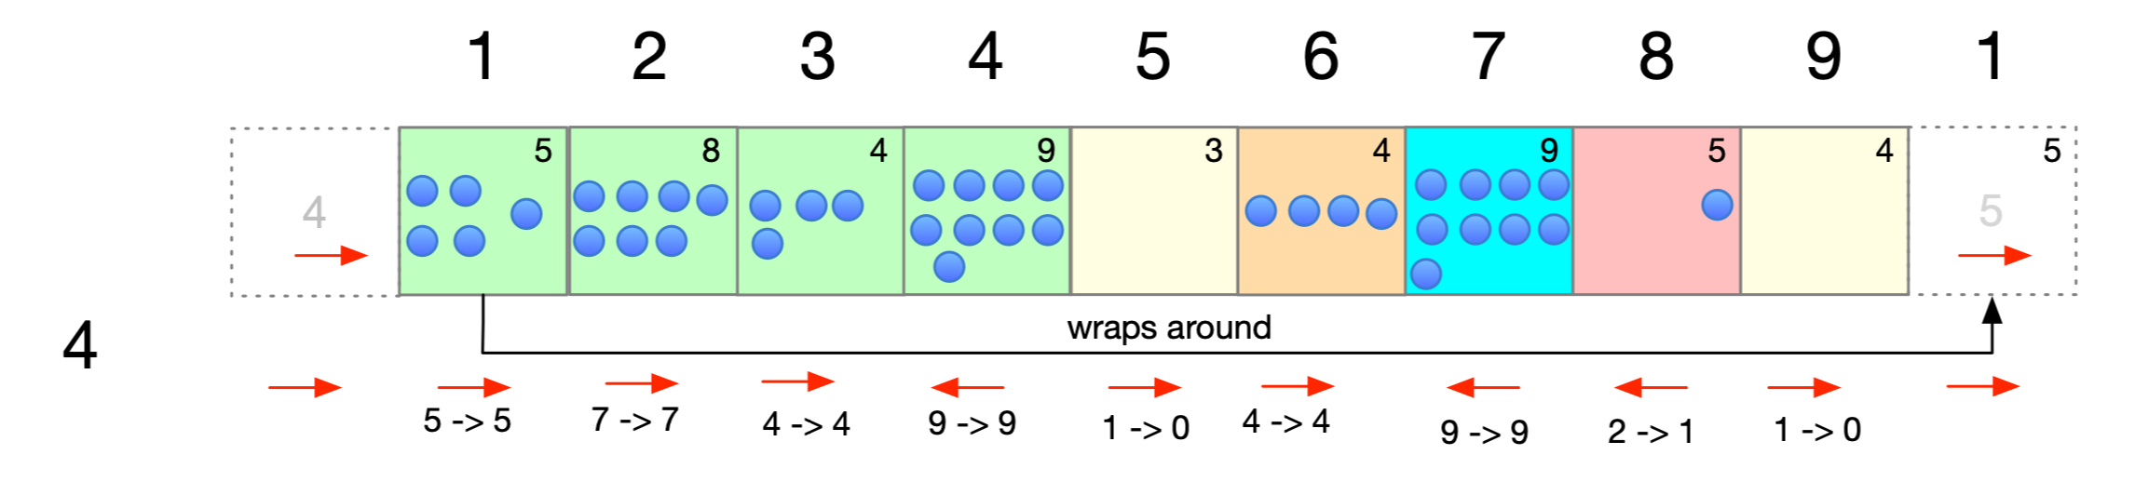
0
0

Slide 29
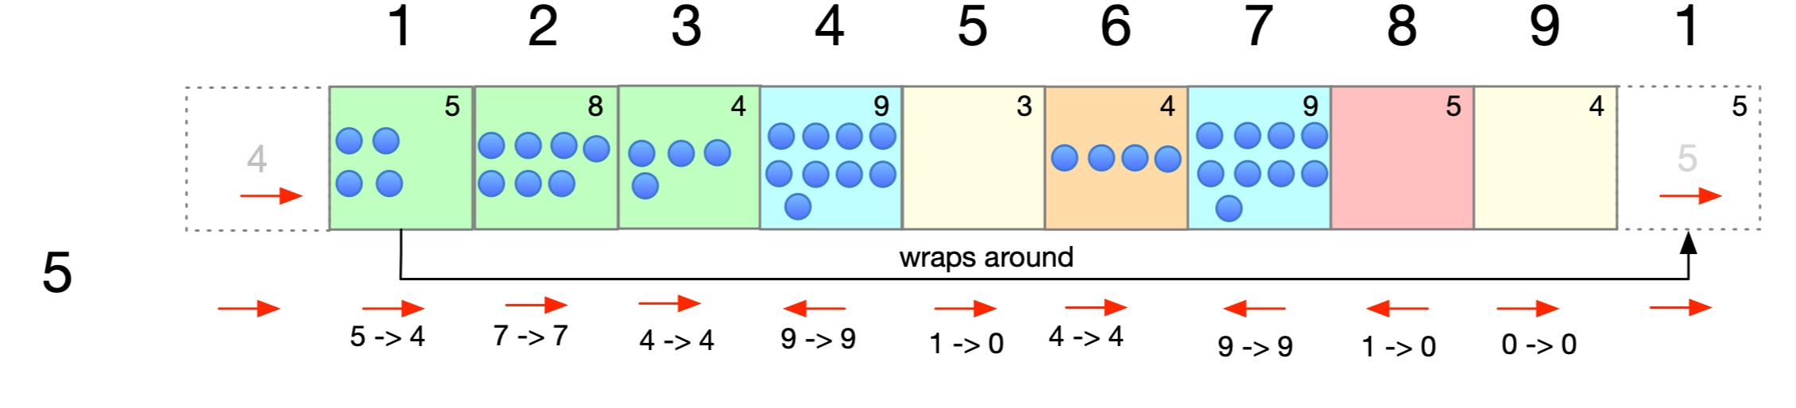

Slide 30
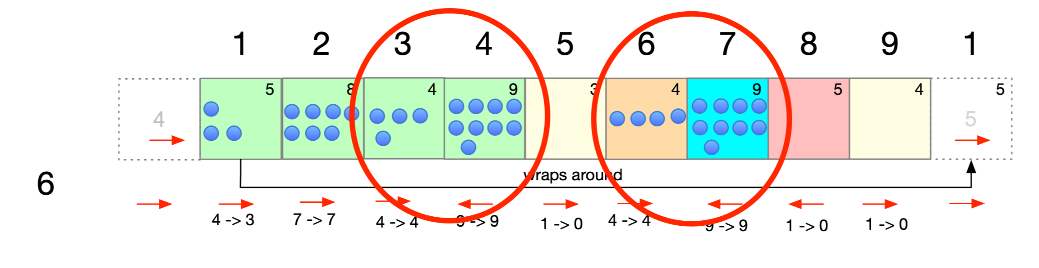
0
Stable
Stable
0
0
0

Slide 31
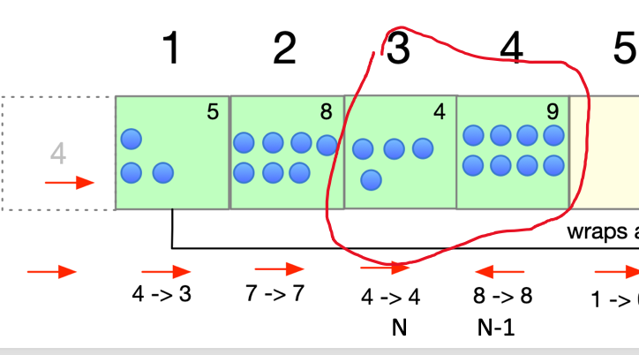
lets figure out when the system goes stable
we are here after 5 minutes
in the next three minutes the three bones in bowl 1 are gone
and we go from 7 bones in 2 to 4 bones
in the next 4 minutes we get rid of the bones in 2
Now we are stable
it took a total of 12 minutes until we are stable
how many bones are in the stable zones> ?
12 Hmmmm a quinky dinky??? nope

Slide 32
Basically the algorithm works like this
Add up all of the bones possible
Identify where the right - left combinations exist Utilize vectors or lists to hold the index for the rights and the indexes for the lefts
Then, every pass through using these indexes add up the bones outside of the stable zones.
These bones get subtracted from the original total and give you a delta
Figure out minute by minute how many bones get dropped - do some examples and see the patterns

Slide 33
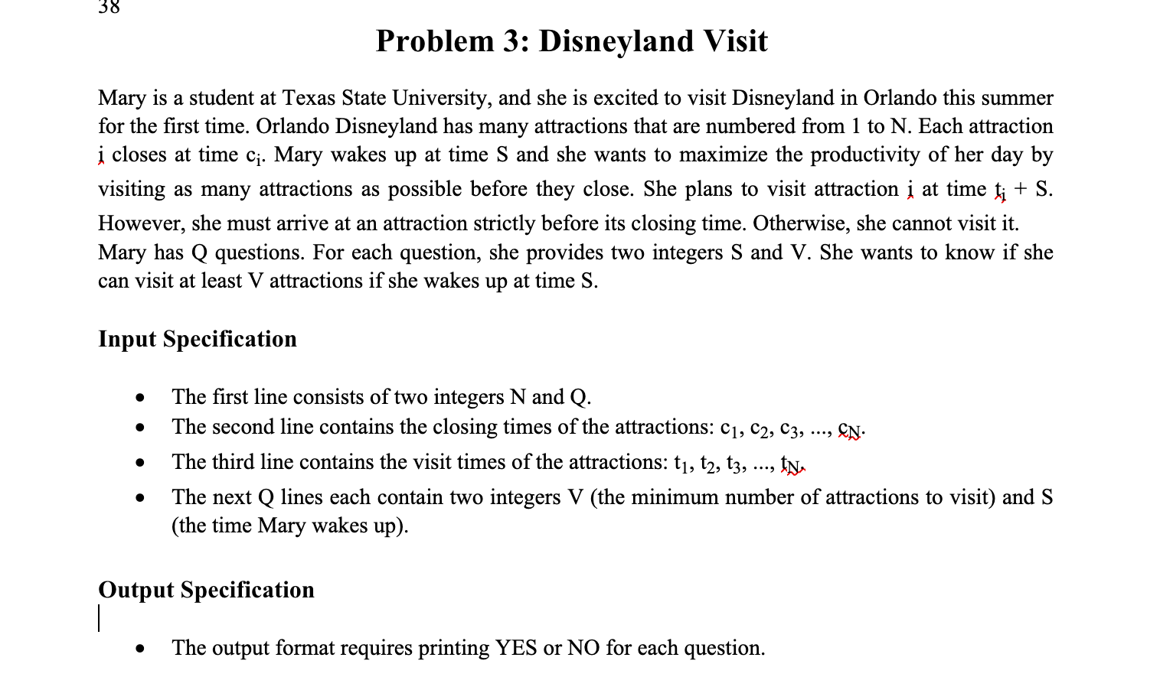
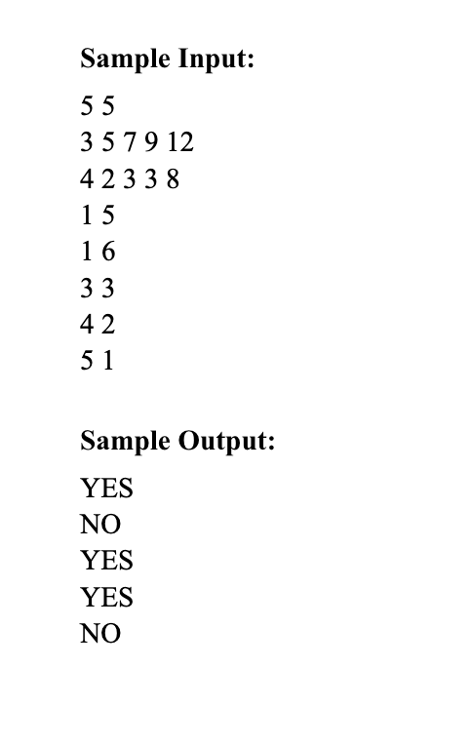

Slide 34
Problem Analysis
Mary is attempting to solve what is typically called an overlapping segment problem
This particular problem is not difficult if you take the time to really understand what is going on.
As is typical with ICPC problems the description leaves room for confusion and clarification, just like in real life!
The key to this problem is that Mary has already decided when she wants to visit each attraction, which then makes the calculation of whether she can see it a calculation exercise.
When she wakes up at time S, she adds the time t she has decided on to S. This is when she can actually show up.
She then compares this time to the closing time. If S + t is LESS than closing, she can visit it, take her selfie for her You Tube channel and leave. Mary is a famous influencer who travels the world “just showing up”. She decided that since she was doing so well at it as a college student, why stop ☺
You then add up the number of attractions she can visit
I think the hardest part of the problem is to remember to print YES or NO

Slide 35
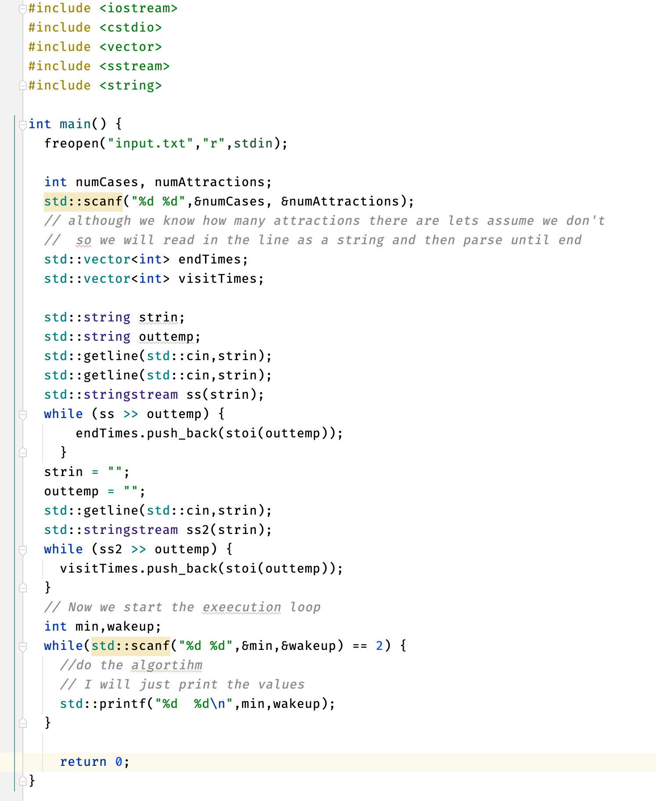
Input in C++

Slide 36
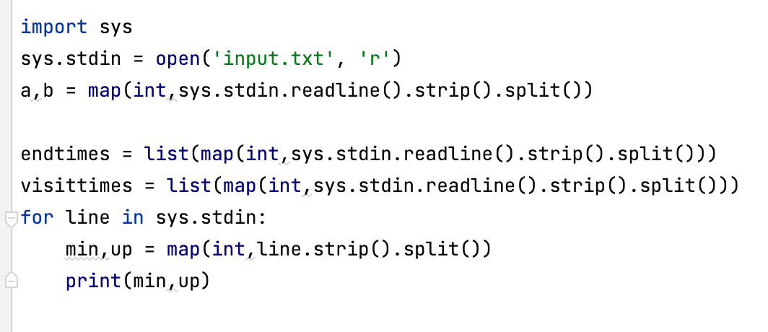
Input in Python

Slide 37
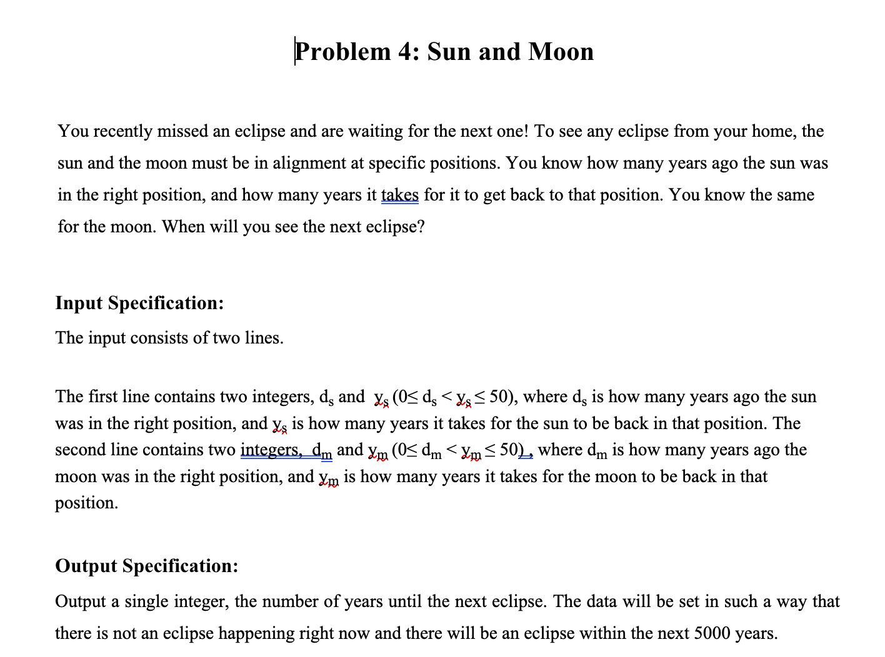
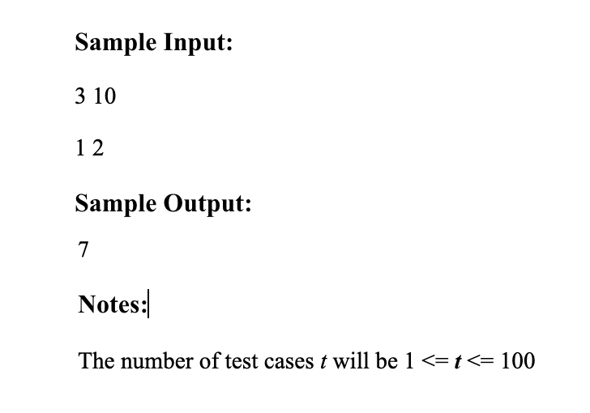

Slide 38
Problem Analysis
With now(time) as zero
sun time until alignment (oksun) from now <- time to be in position(ys) - time last in alignment(ds)
moon time until alignment(okmoon) from now <- time to be in position(ym) - time last in alignment(dm)
Eclipse not now so 0 for both not allowed
If oksun or okmoon negative add time to be in position until positive time from now
time to eclipse minimum = max(oksum, okmoon)
while oksun != okmoon:
if okmoon < oksun -> okmoon += ym
else if oksun < okmoon -> oksun += ys
Concept is to keep adding period to both until the are equal

Slide 39
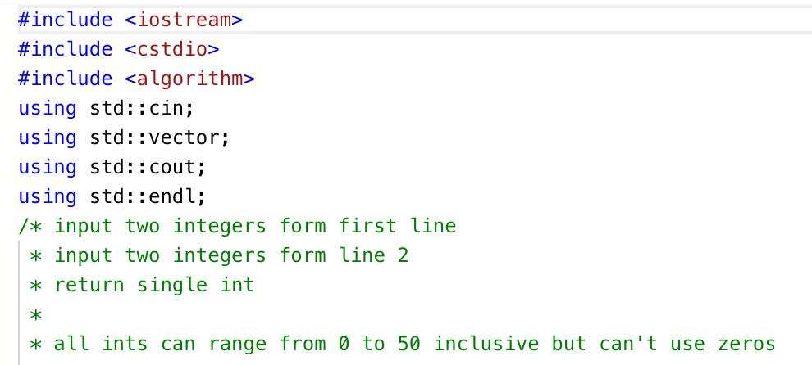
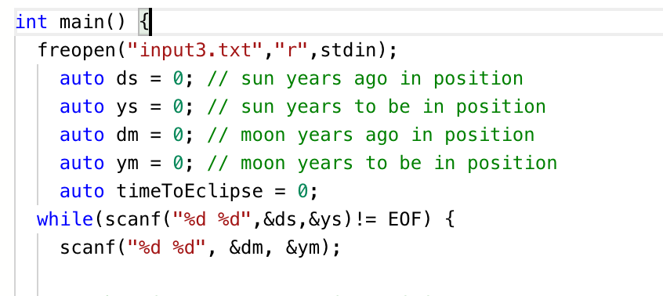

Slide 40
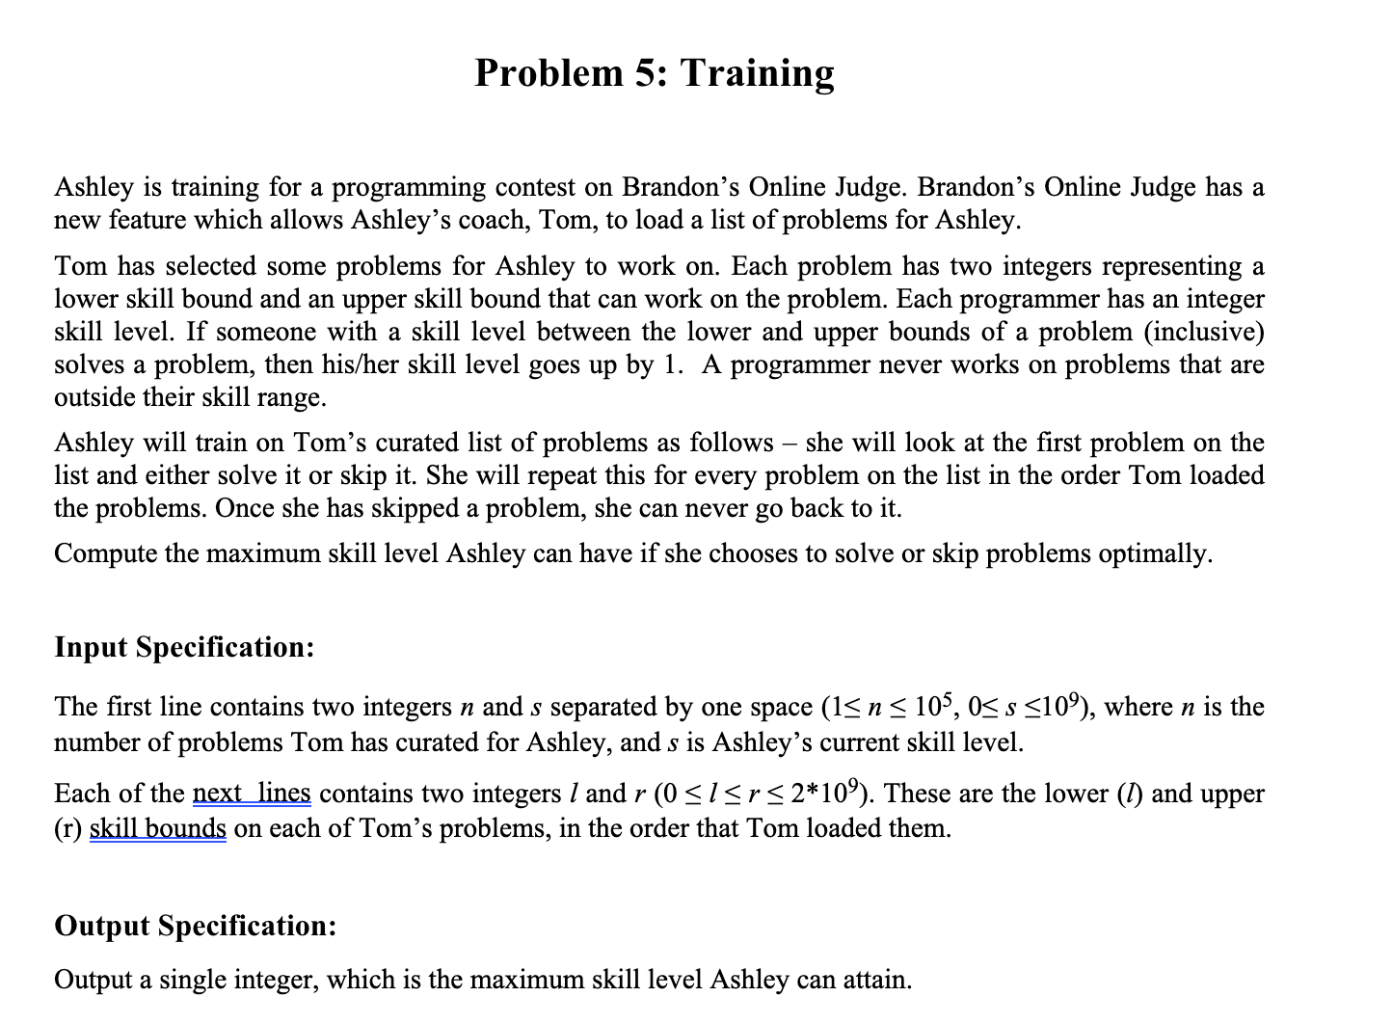
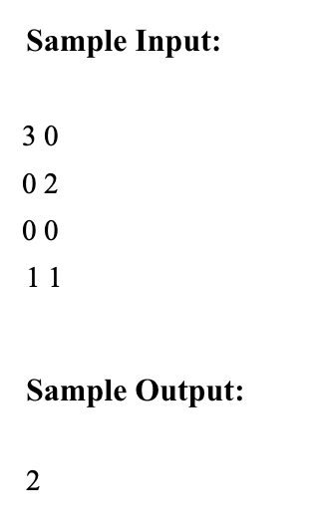

Slide 41
Problem Analysis
This is a greedy algorithm problem since she just does them in order
Use a queue to store the problems in order
Look at each problem and if her current difficulty range allows it , do it
Update difficulty range if appropriate
Look at the next problem

Slide 42
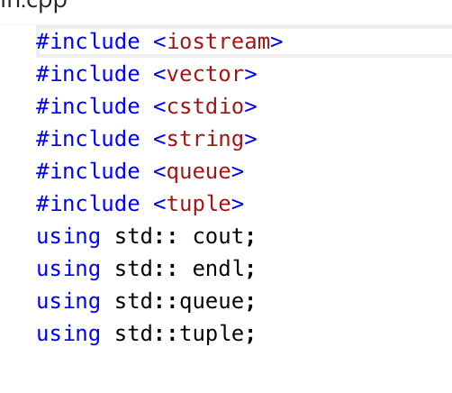
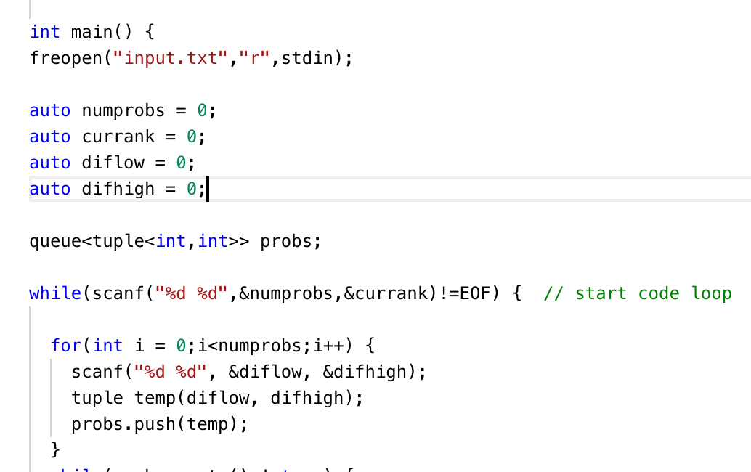

Slide 43

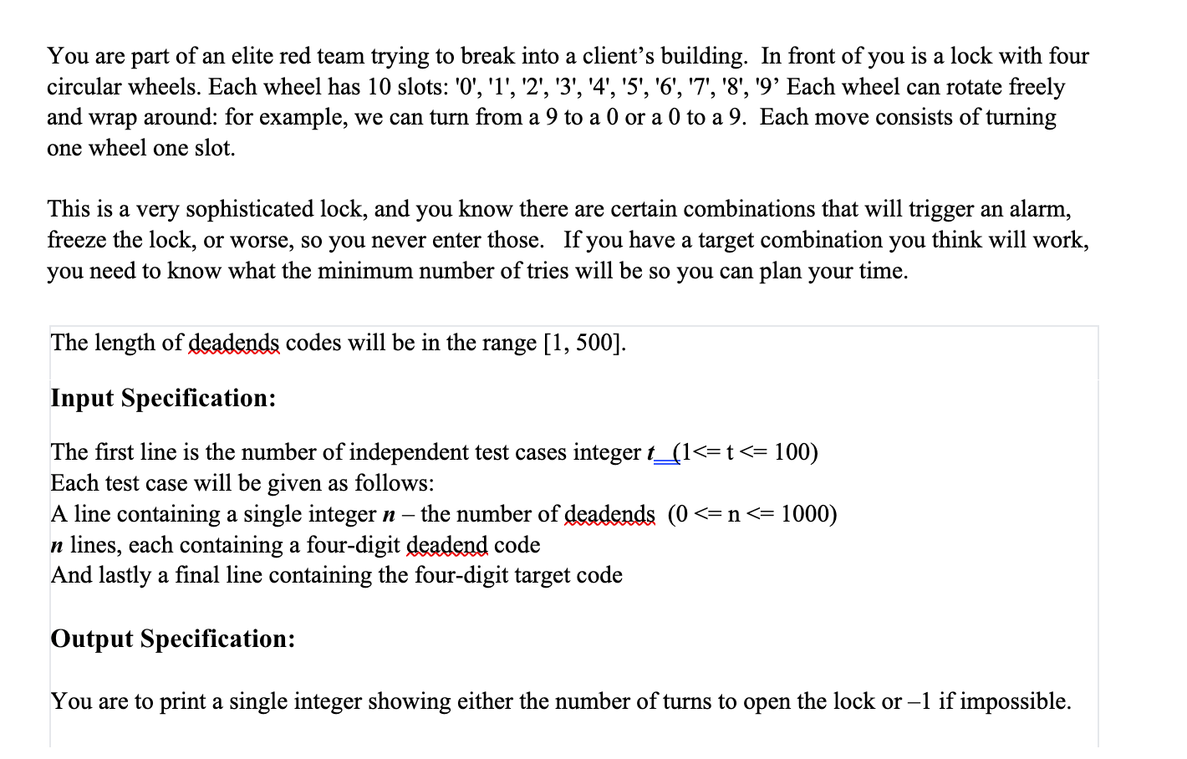

Slide 44
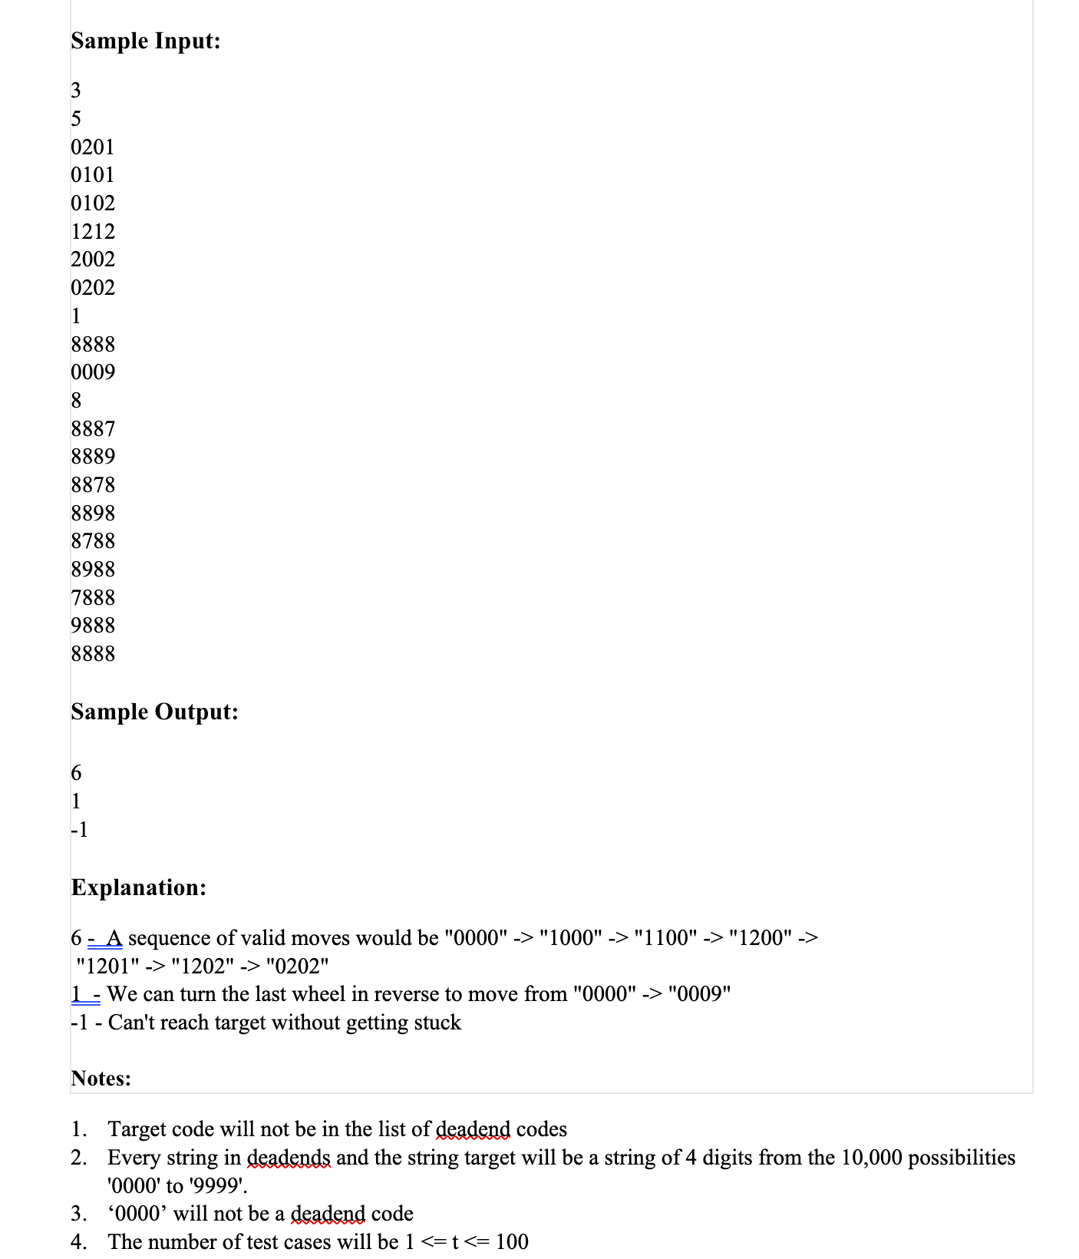

Slide 45
Problem Analysis
This can be looked at as a graph problem where the nodes are the “state” of the lock after one disk click
Its also similar in thinking to n-queens
Breadth first in both pos and neg directions
Need to know what states we have looked at so we can count the number of moves
We use a visited set and start with all of the dead ends in the set. We will not visit them
As we move, we put each state into visited so we don’t reuse them
We start at 0000 put in a queue
Make sure that 0000 is not a forbidden state, if so error
Starting with the top of the queue try to move each digit 1 in each direction
If ok Put each state in queue
pop top of queue and repeat process with next state in queue

Slide 46
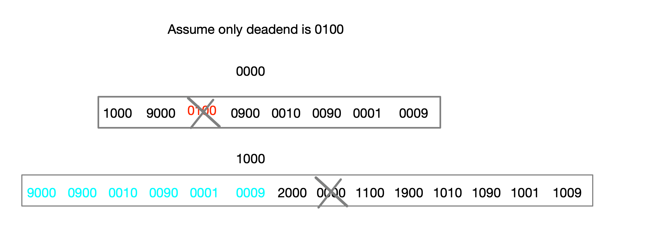
How the queue evolves

Slide 47
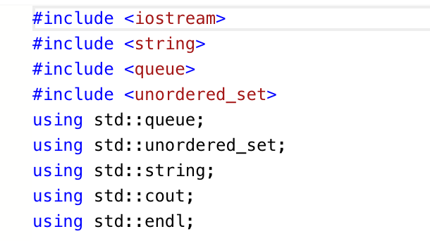
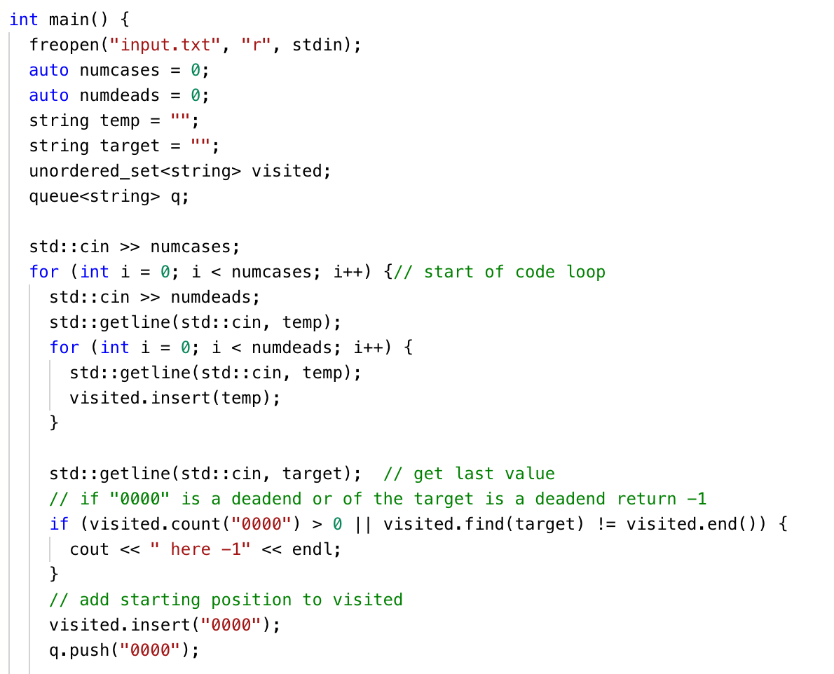

Slide 48
